Slide 1
AES Algorithm
Thais Campanac - Bonus Project

Slide 2
What is the AES Algorithm?
There are 11 parts… which can be reduced into 5 main parts
Expanding key
Substituting
Shifting rows
Mixing columns
Adding Round Key
Note: this is instruction for the 128bit version

Slide 3
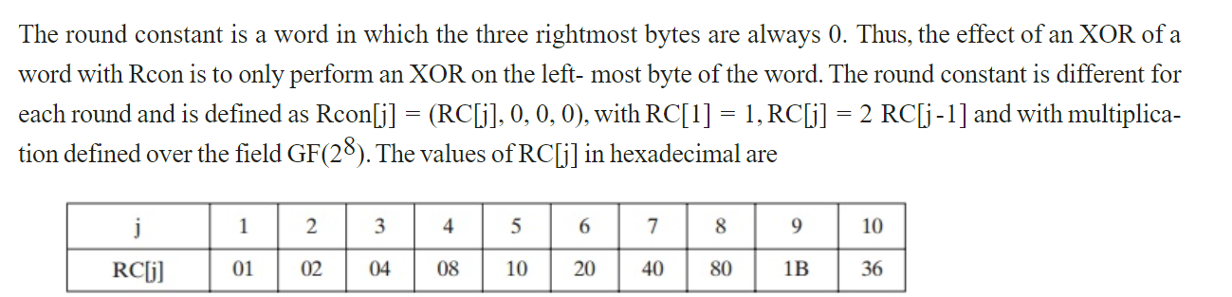
Expanding key (Key Schedule)
Input is 128 bits
Divide the bits into 32 bits and with those bits
Shift the bits left by 1
Substitute each 8 bit by a value in S-Box
Add the round constant
The round constant changes each round (I used a function and a module together to give different
values)

Slide 4
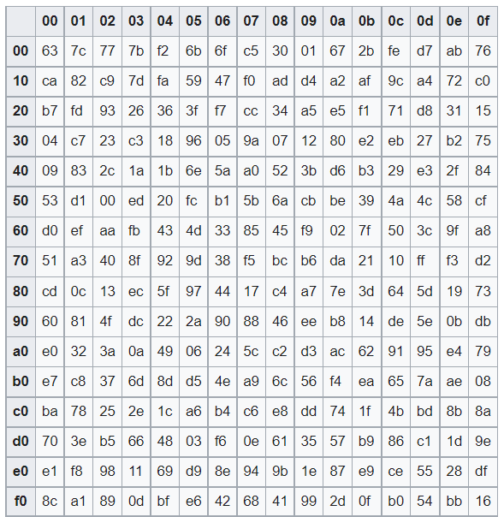
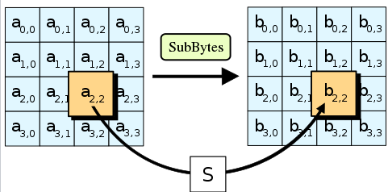
Substituting Round
Input 128 bits of data
Replace each 8 bits with a value in the s-box

Slide 5
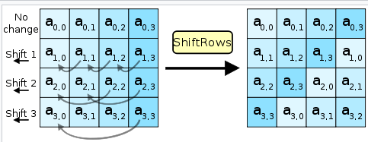
Shifting round
Input 128 bits of data

Slide 6
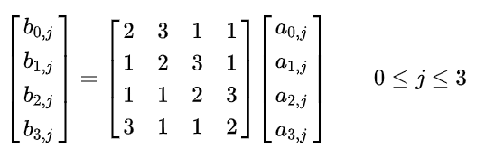
Mixing Column
It’s basically a giant Matrix Multiplication
Each column results in 4 different equations
2x0 + 3x1 + x2 + x3 x0 + 2x1 + 3x2 + x3 x0 + x1 + 2x2 + 3x3 3x0 + x1 + x2 + 2x3
What about the overflow???

Slide 7
Add Round Key
…it’s as the title says

Slide 8
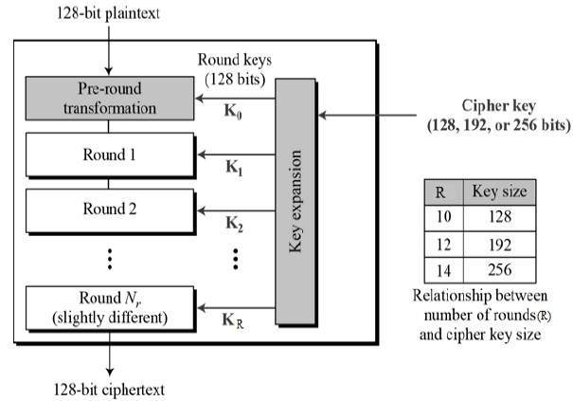
Putting it all together

Slide 9
Work Cited
https://www.kavaliro.com/wp-content/uploads/2014/03/AES.pdf
https://www.brainkart.com/article/AES-Key-Expansion_8410/
https://en.wikipedia.org/wiki/Advanced_Encryption_Standard#The_MixColumns_step
https://en.wikipedia.org/wiki/Rijndael_S-box

